Slide 1

Intro to:

Slide 2
Documentation and examples:
https://github.com/alatriste1982/protractorCourse

Slide 3
What is Protractor?
Protractor is an end-to-end test framework for AngularJS applications.
It runs tests against your application running in a real browser, interacting with it as a user would.
It is built on top of WebDriverJS
Protractor supports Angular-specific locator strategies, which allows you to test Angular-specific elements without any setup effort on your part.
You no longer need to add waits and sleeps to your test (mostly). Protractor can automatically execute the next step in your test the moment the webpage finishes pending tasks

Slide 4
Protractor vs Webdriver (1)
Protractor:
describe('angularjs homepage', function() { it('should add one and two', function() {
browser.get('http://juliemr.github.io/protractor-demo/');
element(by.model('first')).sendKeys(1); element(by.id('gobutton')).click();
expect(element(by.binding('latest')).getText()). toEqual('3'); });
});
Want to read more? http://testautomation.applitools.com/post/94994807787/protractor-vs-selenium-which-is-easier

Slide 5
Protractor vs Webdriver (2)
Webdriver:
var assert = require('assert'),
test = require('selenium-webdriver/testing'),
webdriver = require('selenium-webdriver');
test.describe('Google Search', function() {
test.it('should work', function() {
var driver = new webdriver.Builder().withCapabilities(webdriver.Capabilities.chrome()). build();
driver.get('http://www.google.com');
driver.findElement(webdriver.By.name('q')).sendKeys('webdriver');
driver.findElement(webdriver.By.name('btnG')).click();
driver.getTitle().then(function(title) {
assert.equal(title, 'webdriver - Google Search'); });
driver.quit();
});
});
Want to read more? http://testautomation.applitools.com/post/94994807787/protractor-vs-selenium-which-is-easier

Slide 6
Protractor vs Webdriver(3)
describe('angularjs homepage', function() {
it('should add one and two', function() {
browser.get('http://juliemr.github.io/protractor-demo/');
element(by.model('first')).sendKeys(1);
element(by.id('gobutton')).click();
expect(element(by.binding('latest')).getText()). toEqual('3'); });
});
var assert = require('assert'),
test = require('selenium-webdriver/testing'),
webdriver = require('selenium-webdriver');
test.describe('Google Search', function() {
test.it('should work', function() {
var driver = new webdriver.Builder().withCapabilities(webdriver.Capabilities.chrome()). build();
driver.get('http://www.google.com');
driver.findElement(webdriver.By.name('q')).sendKeys('webdriver');
driver.findElement(webdriver.By.name('btnG')).click();
driver.getTitle().then(function(title) {
assert.equal(title, 'webdriver - Google Search'); });
driver.quit();
});
});

Slide 7
Why do we use protractor ?
Allows access to all webdriver methods with additional angular specific locator strategies
Simple setup
Less sync issues
Uses jasmine bdd framework
Can run tests on remote addresses
Can run tests on multiple browsers

Slide 8
Installation
Requirements:
NodeJs (https://nodejs.org)
Python 2.7.xx (https://www.python.org/downloads/)
Windows only:
Node-gyp (requires visual studio C++ 2012 Express)
Installation (npm install protractor -g)
IEDriver to run tests with Internet Explorer (http://www.seleniumhq.org/download/) Install 32bit version, the 64bit driver is too slow

Slide 9
A Simple Test
Navigate to a page
Check the page title
Example time!!! (simple-test.conf.js)

Slide 10
Basic test structure
Config file
Spec file
And ideally, one or more:
Page object file

Slide 11
Config File
A simple config file:
exports.config = { seleniumAddress: 'http://localhost:4444/wd/hub', specs: ['todo-spec.js'] };
My real config file: https://docs.google.com/document/d/1LHKZnc6suTGkiZ4OLF0g2vIEj56kDkQTMt8mzU_xEP4/edit
The reference config file: https://github.com/angular/protractor/blob/master/docs/referenceConf.js

Slide 12
Interacting with elements
Go to https://angularjs.org
Add an item to the Todo list
Mark it as done
Check the number of done tasks is correct
Example time!!! (interacting-spec.conf.js)

Slide 13
Interacting with elements (2)
Globals:
element: Takes one parameter, a Locator, which describes how to find the web element
By: creates locators
Locator Examples:
element(by.css('some-css'));
element(by.model('item.name'));to find the element with ng-model="item.name".

Slide 14
Multiple tests
Example: multiple-tests.conf.js
More locators:
by.model('first') to find the element with ng-model="first".
by.id('gobutton') to find the element with the given id
by.binding('latest') to find the element bound to the variable latest. This finds the span containing {{latest}}

Slide 15
About locators
Never use Xpath (xpath locators are brittle)
Use protractor locators when possible (Simple and readable, less likely to change)
Prefer by.id and by.css when no Protractor locators are available (very performant)
Try to avoid text locators (they tend to change over time)

Slide 16
Manage browsers
Tests running in Firefox:
multiple-tests.firefox.conf.js
Multiple browsers:
Example: multiple-tests.multiple-browsers.conf.js

Slide 17
Page Objects Model
It’s an aplication specific API.
A page object wraps an HTML page, or fragment allowing you to manipulate page elements without digging around in the HTML.
It’s a design pattern to create an Object Repository for web UI elements.
For each web page in the application there should be at least one page class.
The Page class will find the WebElements of that web page and also contains Page methods which perform operations on those Web Elements.
Name of these methods should be given as per the task they are performing

Slide 18
Page object vs no page object
Examples:
Simple:
pageObjectVsNotPageObject.conf.js
Real (my own project):
specs/translations.js

Slide 19
Advantages of the page object model
Improves the maintainability of tests (Any UI change will only impact one page object)
Makes tests more readable and robust
Encapsulates functionality
Helps reduce duplication of code
Provides an interface that is easy to program
Easier to define responsibilities

Slide 20
Protractor API
4 main groups of methods:
Element manipulation(a) and location(b):
element(locator) Examples: getWebElement, click, sendKeys, isElementPresent
Locators. Examples: by.css, by.model, by.id
Browser setup(a) and handling(b):
Setup: Options.addCookies, Window.maximize, getProcessedConfig
handling: get, executeScript, switchTo
Expected conditions
Promise handling
http://www.protractortest.org/#/api

Slide 21
Test data
You can easily retrieve test data from json files
Example: testData-example.conf.js

Slide 22
Basic Project structure
/* recommended */ |-- project-folder |-- app |-- css |-- img |-- js |-- controllers |-- directives |-- services app.js index.html |-- test |-- unit |-- e2e |-- page-objects home.pageObject.js profile.pageObject.js home.spec.js profile.spec.js
/* avoid */ |-- project-folder |-- app |-- css |-- img |-- js |-- controllers |-- directives |-- services app.js index.html |-- test |-- unit |-- e2e home.pageObject.js home.spec.js profile.pageObject.js profile.spec.js

Slide 23
Test reports:
Jasmine reporters
https://github.com/larrymyers/jasmine-reporters
AppVeyor - POSTs results to AppVeyor when running inside an AppVeyor environment.
JUnitXmlReporter - Report test results to a file in JUnit XML Report format.
NUnitXmlReporter - Report test results to a file in NUnit XML Report format.
TapReporter - Test Anything Protocol, report tests results to console.
TeamCityReporter - Basic reporter that outputs spec results to for the Teamcity build system.
TerminalReporter - Logs to a terminal (including colors) with variable verbosity.
Jasmine to HTML reporter
https://www.npmjs.com/package/protractor-jasmine2-html-reporter

Slide 24
JS Promises
promise.then(function(value) { // Do something with the 'value' });
A promise is a method that eventually produces a value
A promise is in one of three different states:
pending - The initial state of a promise.
fulfilled - The state of a promise representing a successful operation.
rejected - The state of a promise representing a failed operation.
promises take two handler functions as parameters:
fulfill
Reject

Slide 25
JS Promises (2)
Promises are chainable
angularHomepage.get()
.then(angularHomepage.setName)
.then(angularHomepage.getGreeting()

Slide 26
Protractor promises and control flow
WebDriverJS (and thus, Protractor) APIs are entirely asynchronous. All functions return promises.
it('should find an element by text input model', function() { browser.get('app/index.html#/form'); var username = element(by.model('username')); username.clear(); username.sendKeys('Jane Doe'); var name = element(by.binding('username')); expect(name.getText()).toEqual('Jane Doe'); // Point A });
WebDriverJS maintains a queue of pending promises, called the control flow, to keep execution organized.
What happened at point A??????????

Slide 27
Protractor promises (2)
This will fail
This will work
browser.get(initialNav);
page.login(account.username, account.password);
var url = browser.getCurrentUrl();
global.currentSession = helpSession.getSession(url);
Why?:
page.login can fail if the initial nav is slow
getSession will always fail. instead of a url string the method is receiving an unresolved promise
browser.get(initialNav).then(function () {
page.login(account.username, account.password);
browser.getCurrentUrl().then(function (url) {
global.currentSession = helpSession.getSession(url);
});
});

Slide 28
Protractor problems
Protractor control flow:
Must understand promises
Weird stack traces
Debugging:
Debugging
Elementor (https://github.com/andresdominguez/elementor)

Slide 29
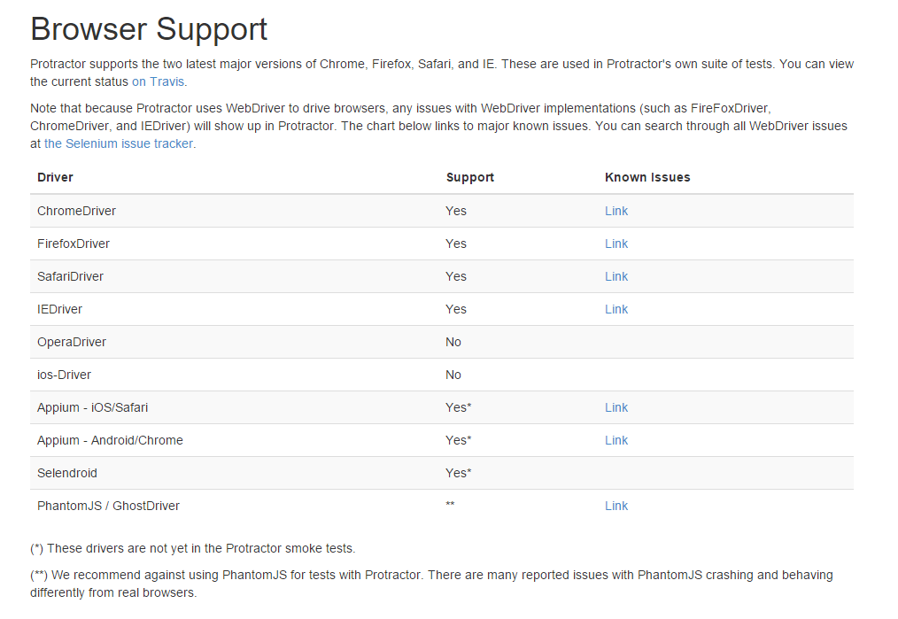

Slide 30
Resources
http://www.protractortest.org/
https://github.com/CarmenPopoviciu/protractor-styleguide (Excelente guía de estilo para escribir tests en protractor)
Elementor: https://github.com/andresdominguez/elementor

